Slide 1
Inclusive Language Commitment
Arm is committed to making the language we use inclusive, meaningful, and respectful. Our goal is to remove and replace non-inclusive language from our vocabulary to reflect our values and represent our global ecosystem.
Arm is working actively with our partners, standards bodies, and the wider ecosystem to adopt a consistent approach to the use of inclusive language and to eradicate and replace offensive terms. We recognise that this will take time. This course may contain references to non-inclusive language; it will be updated with newer terms as those terms are agreed and ratified with the wider community. We recognise that some of you will be accustomed to using the previous terms and may not immediately recognise their replacements. Please refer to the following examples:
When introducing the AMBA AXI Protocols, we will use the term ‘Manager’ instead of ‘Master’ and ‘Subordinate’ instead of ‘Slave’.
Contact us at education@arm.com with questions or comments about this course. You can also report non-inclusive and offensive terminology usage in Arm content at terms@arm.com.

Slide 2
Introduction
Operating System Lab-in-a-Box
Notes:
Arm®‘s worldwide University Program ships 'Lab-in-a-Box' (LiB) with its partners to higher educational institutions around the globe. The LiB contains Arm-based technology and high quality, rigorous training materials that support electronics and computer engineering courses. The Lab-in-a-Box (LiB) package includes hardware boards from Arm partners, software licenses from Arm, and complete teaching materials ready to be immediately deployed in classes.
In this lecture we talk about the Operating System, RTX (Arm Keil’s real time operating system, RTOS) that can be used in the Lab-in-a-Box environment.

Slide 3
Course Overview
Around 13 lectures
Covers some of the most important aspects of operating systems
Particular emphasis on embedded systems and Real Time OS (RTOS)
Illustrate details using RTOS examples
Labs and assignments are intended to help you understand both the concepts and implementation of OS components
Hands on experience in developing multithreaded applications on a RTOS
Notes:
This course has 13 lectures and covers an array of topics regarding Real time Operating System (RTOS). RTOS examples and Lab assignments with RTOS are presented over the 13 lectures. Hands on experience in developing multithreaded applications on a RTOS is also covered.

Slide 4
Brief History
The Abacus
Ancient tools, widely used in various regions
Logarithms
John Napier and Napier’s Bones
Pascal’s calculator: the Pascaline in 1642
Mechanical digital calculator
Notes:
For centuries, humans were developing various computing tools to make our life easier. One of the first tools to help, in relation to counting, was the Abacus. It had beans or stones that could be moved at various levels on a tablet of wood. Logarithms were invented by John Napier, a Scottishman, to help in arithmetic. A mechanical calculator which was used to add and subtract was invented by Pascal in 1642.

Slide 5
Brief History
Difference and Analytical Engines
Charles Babbage
Ada Lovelace
Never built
Turing completeness machine
A precursor for modern computers in some sense
Punched Card Machinery - 1890
Vacuum Tubes – 1905
Relay Calculators – 1935
Z3 – 1941
Colossus -1943
Notes:
The first Mechanical Computer was invented by Charles Babbage (1791-1871). He designed the “Difference Engine” and “Analytical Engine”. The difference engine performed calculator functions and the analytical engine did general purpose computation.
In 1936, Alan Turing invented, what was called a “Turing machine”, to compute using any algorithm.
As new technologies were invented, new type of computers were designed; punched cards for input/output, vacuum tubes, transistors, mechanical relays etc. played important roles in the history of computer design. Konrad Zuse designed Z 3, an electromechanical computer with relays and punched film inputs to perform programmable digital computations.
Programmable electronic computers with vacuum tubes were built in 1943-45, named Colossus, for the British military.

Slide 6
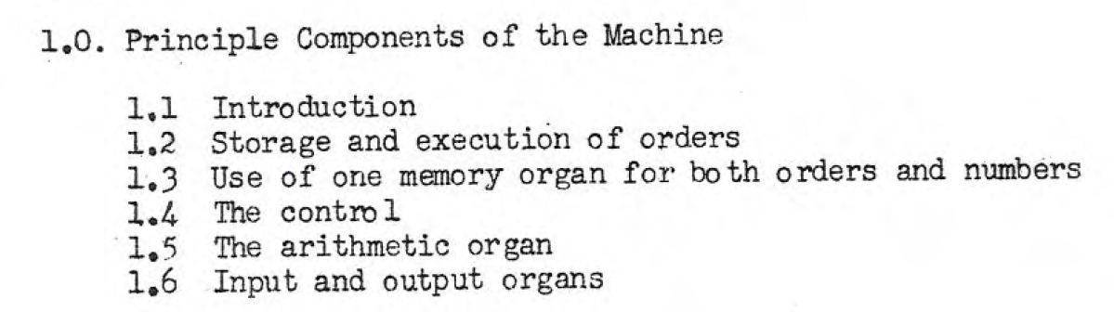
Brief History
Turing Machine
On computable numbers, with an application to the Entscheidungsproblem – 1936
Intelligent machinery – 1948
Model design of CPU
Preliminary Discussion of the Logical Design of an Electronic Computing Instrument - 1947
Arthur Burks, Herman Goldstine, John von Neumann
Stored-program computer
Looks familiar?
Notes:
The “Turing Machine” invented by Alan Turing used a paper tape reader for input. This machine solved Entscheidungsproblem (1928) problems with logic rules.
Arthur Burks, Herman Goldstine, and John von Neumann described a Stored-program computer, in 1947.

Slide 7
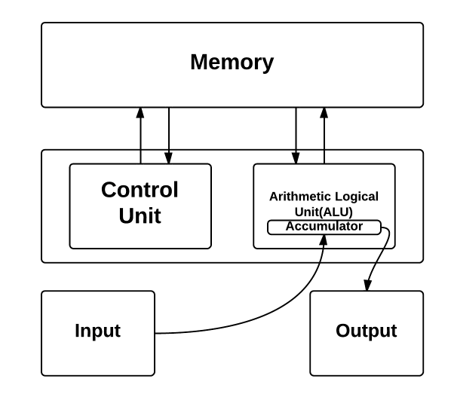
Brief History
Von Neumann Architecture
First Draft of a Report on the EDVAC – 1945
A standard for a modern computer
Both data and program are stored in the memory
ENIAC - 1946
Electronic Numerical Integrator And Computer
Took weeks to program the plug board
Vacuum tubes, 150 kW
Decimal
Notes:
In 1945, Von Neumann designed the first stored program computer with 4 major blocks: memory, CPU (Central Processing Unit) consisting of a control unit and an arithmetic logic unit, input and output. It was called EDVAC and his architecture was the standard for the next generations of computers.
The ENIAC computer with vacuum tubes was built in 1946. The arithmetic was done in the decimal system.

Slide 8
Suggested Reading
First Draft of a Report on the EDVAC
Preliminary Discussion of the Logical Design of an Electronic Computing Instrument
For the fanatics only
Notes:
EDVAC (Electronic Discrete Variable Automatic Computer) was one of the earliest electronic computers.
This was a stored program computer and it had 6,000 vacuum tubes and 12,000 diodes, and consumed 56 kW of power.
For more information on EDVAC refer: https://en.wikipedia.org/wiki/EDVAC

Slide 9
How did the OS come into existence
No OS
Manually transferred programs by using switches
Simple interface like blinking lights on a panel
Sign-up sheets as a scheduling tool
Single user had to set up everything
Then an operator
Programs written in punched card
Operator will handle the task submitted by users and return the result to them
Standard card libraries
Early OS: batch system
Monitor, permanently resident in the memory
Handle a batch of jobs without user interaction
Problematic
Notes:
Initially, computers did not have an operating system above the hardware unit. The user programmed the registers and stored data and instructions in memory using switches.
The next wave of computers had programs written in punched card. The operator fed the card bundle from the user into the computer and the result was presented on printed paper. The results were then handed over to the user. If there was an error in one card (punching hole error or syntax error) the cards would be returned to the user for correction. Some times it took a few days to run a program without errors and get the correct results.
The early stages of operating systems provided simple functions like monitoring memory, handling batch jobs in a sequence and printing the results.

Slide 10
How did the OS come into existence
Multiprogramming
Multiprogramming shortens the time that the CPU is blocked by I/O, thus, better utilisation
OSs have to be more sophisticated in terms of handling memory for various tasks and schedule the next task once the CPU is blocked by I/O
The very essentials of OS
Burroughs MCP – 1963
IBM’s System/360
Time sharing system
Users would like to interact with the computer as well
Interactive terminal access: time slices for users
OS and Personal Computer
Notes:
Operating System development started in order to improve performance and efficiency. One of the functions of the OS was multiprogramming which allowed several programs to run on the processor simultaneously. The operating system executes a portion of one program, then a part of another, and so on. To the user it appears that all programs are executing at the same time, however it is the processor sharing time between each program. The I/O and CPU use were done in parallel. Any users interacting from a I/O (input/output) terminal are very slow while the CPU is very fast. The processor spends fractions of seconds with each user to receive their data and process them for a short time (Sharing time on the CPU between each user). The user thinks that he/his program is using the computer at all times, however the computer serves many users/programs.

Slide 11
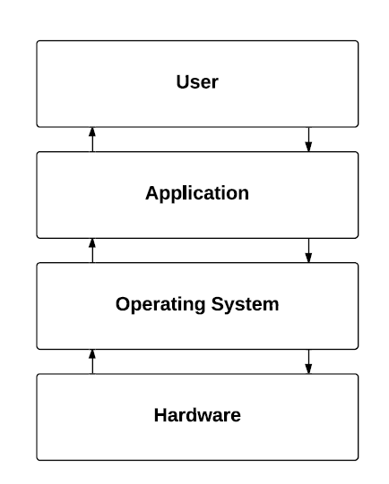
OS Does the Plumbing
OS provides an abstraction of the messy hardware
Hardware is detailed and specific
Manipulating hardware requires not only programming knowledge, but also understanding of the hardware
User/Programmer does not have to care about the “pipes”, simply turn on and off the “tap”
More productive
Notes:
The purpose of operating systems is to make the user code or application program movable to any computer. The user need not be aware of the hardware architecture, the amount of memory and registers it has, or the port programming details. Operating systems hide the hardware details from the user and act as a layer of abstraction. As the picture shows, the OS is on top of the hardware and the application software runs on top of the operating system. Multiple applications will use the software library provided by the operating system for controlling the hardware. The operating system software stays on top of the computer hardware and software resources and provides many services for the application programs. Normally a programmer should know the details of the processor registers, the flag bits and control bits, mode bits etc., on various registers in the processor. The operating system hides these details from the user and provides common library functions or routines for use by various user application programs.

Slide 12
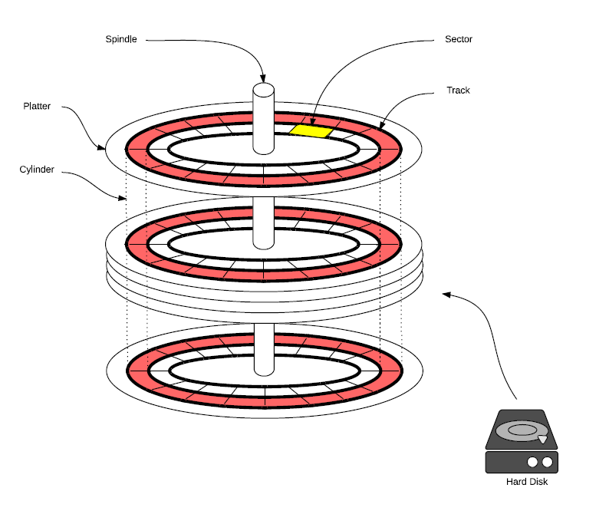
An Example: Writing to Disk
Data from memory to the device buffer
Reading/writing from/to a disk is usually slower than reading/writing from/to memory
Read(DataMemAddr, Size, DeviceId);
Move the read/write head to the right area, identify the platter, track
How does a disk work?
Locate(DeviceId, PlatterId, TrackId);
Finally write to the track cluster
Write(DeviceId, Cluster);
Notes:
For example, to write data into some hard disk memory, the operations involved would include reading the data from memory or a register, select the right trace, cylinder, and sector etc. on the hard drive. The writing operation into the disk takes more time. All these operations are taken care of by the OS.

Slide 13
An Example: Writing to Disk
OSs offer a simplified Write function that encapsulates the aforementioned commands
Also, a logical address instead of the physical address is provided:
Write(DataMemAddr, Size, DeviceId, LogAddr);
An even more abstracted function is common
Treat memory and the disk as the same file storage
A unified file identification FieId
And then use a library such as “C stdio”
Write an integer variable, datum, onto the disk at an implicit offset from the beginning of the file
fprintf(FileId, “%d”, datum);
“Everything is a file” philosophy (Unix)
Notes:
For example, writing data to disk involves the OS doing the operations mentioned in the slide. The programmer uses a logical address to store the data. The OS converts it to a physical address and stores the data at the physical location. We will discuss the logical address to physical address conversion concept in the later modules.

Slide 14
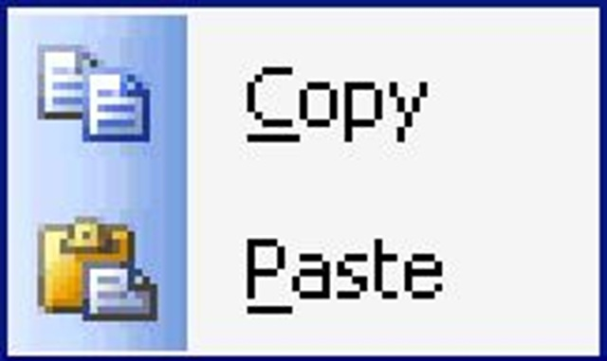
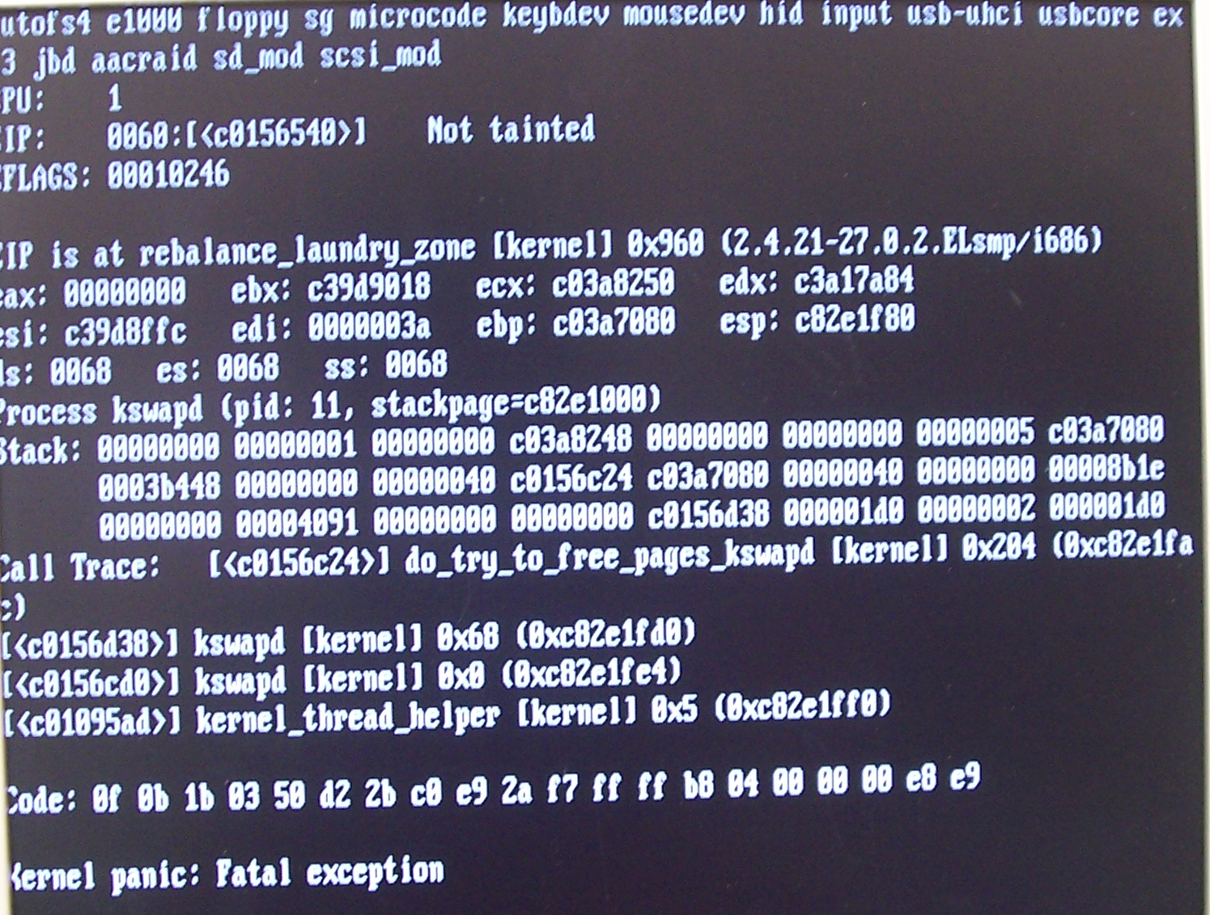
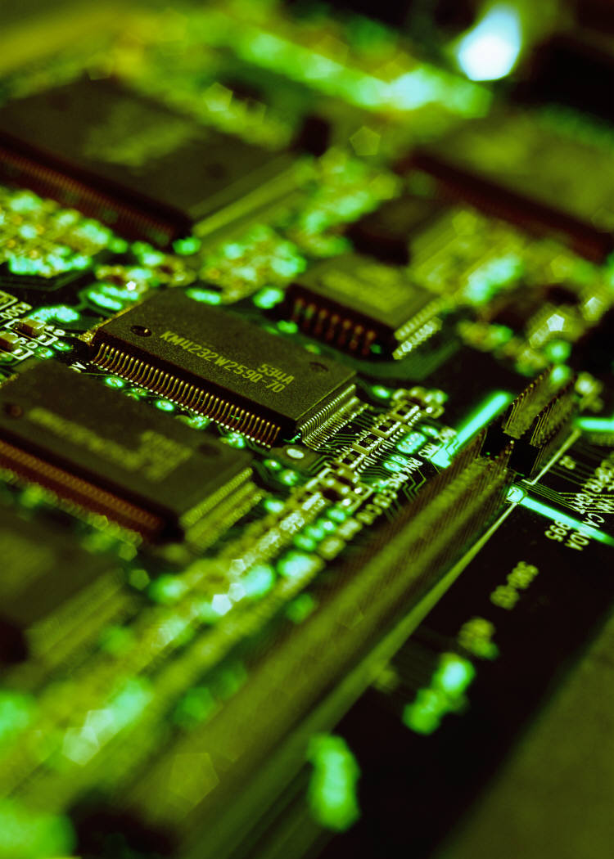
More examples
User’s view: copy, paste, send, save…
Application developer’s view: malloc(), fork(), open()…
OS programmer’s view: read-disk, start-printer, track-mouse…
“All problems in computer science can be solved by another level of abstraction”
OS provides an abstract programming environment in which specific applications can be further developed to leverage the hardware
The lowest level of abstraction – an abstraction for hardware
User applications – service request – OS – hardware instructions – hardware
Notes:
A few more example operations taken care of by the OS is provided in the slide. Malloc() command handles memory allocation on the system. By using the system call fork(), one can create processes. It takes no arguments and returns a process ID. The purpose of fork() is to create a new process. This created new process is called the child process of the caller. Parent/Child processes will execute the next instruction. The system call “Open” is used to open a new file and obtain its file descriptor.

Slide 15
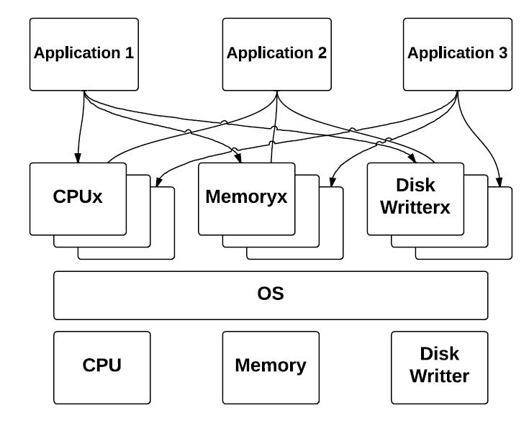
OS Resource Management
OS also plays the role of resource manager
Process management
Memory management
Always limited hardware resources
How to leverage and optimise the use of hardware
Time-multiplexing and space-multiplexing
Control the execution of user applications and I/O devices to avoid errors and misuses
Notes:
OS is on top of the CPU, memory, Disk and I/O devices. OS allocates these units to the various applications in a transparent way. It is done in Time multiplexing and space multiplexing way.

Slide 16
A Dynamic Topic
OS is a traditional computer science topic, yet very dynamic with new challenges:
Post-PC devices and their OS: iOS vs Android
Concurrency and parallelism
Distributed computing and cloud computing
Real time operating system, embedded systems
Security and reliability
Scalability: How to build the next generation of OS? (90’s: below 10 million SLOC, Windows XP 45 million SLOC)
OS for bio-computers, quantum computers? (Abstraction and resource management needed)
Notes:
SLOC = Source lines of code
Operating systems have been facing great challenges with the developments and progress in various hardware units. For example, we have iOS for apple hardware and Android OS for Tablets, Windows OS for desk top PC etc.
The OS provides concurrent and parallel execution and control, distributed and cloud computing. OS is also of two types: real time and non-real time. We need a real time OS for embedded systems like aircraft engine control. We need non-real time OS for a PC based Word processing and accessing internet etc.
Embedded Systems require lean real time OS since they have only limited memory.

Slide 17
Next
OS overview
Basic components
OS structures
Types of OS’s
RTOS
Notes:
In the next set of slides we will review the basic components of OS and RTOS.

